Slide 1
The University of Opportunity
Walsall Skills Summit for Health, Care & Community
Wellbeing and Suicide Prevention
Clare Dickens RNMH MA (Applied MH) PG Cert Ed, T+L in HE and PP (FHEA) FRSA

Slide 2
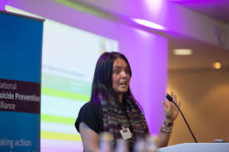
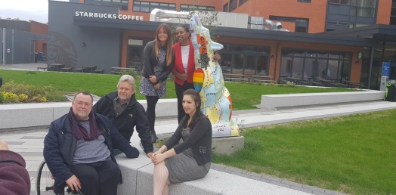

Slide 3
Combining Compassion and Governance

Slide 5
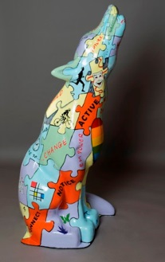
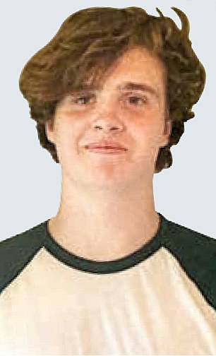
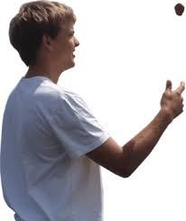
‘I was going to take my own life today, but this exhibition saved my life. Thank you’

Slide 6
Ladder of participation
CO-PRODUCING
CO-DESIGNING
DOING WITH
ENGAGING
CONSULTING
DOING FOR
INFORMING
EDUCATING
COERCION
DOING TO

Slide 7
Organizational Response to wellbeing, resilience and resourcefulness
Wellbeing Toxic
Wellbeing Naïve
Wellbeing Aware Individual actions
Wellbeing Safer
Group actions
Wellbeing Organisational Response
(Cole-King & Peake-Jones 2015)

Slide 8
Suicide naïve
Suicide aware
Suicide alert
Suicide safer
Safe from suicide
Organizational Response to Suicide
(Cole-King 2015)
Notes:
Suicide Naïve: You have little or no knowledge of suicide and do not think that suicide or suicide prevention has any relevance to you or your organisation. Due to this you are highly likely to be fearful of encounters involving suicide and you may not be aware of the latest evidence and may have negative experiences of this area in the past
Suicide Aware: You are aware of suicide in general but you’re understanding is limited to what you see online or in the media. although you are aware you do not have the confidence, skills of knowledge to know what to do to prevent suicide. This can be extremely anxiety provoking as you are aware of the issues but feel unable to respond safely. This can also cause ‘organisational anxiety’ and unconsciously cause either excessive or inadequate response to identified risk.
Suicide Alert: You now have a the attitudes, skills, knowledge, confidence and governance to identify and respond appropriately to someone at risk of suicide although this may still not be across the whole organisation
Suicide Safer: You have an excellent understanding of suicide with the attitudes, skills, knowledge, confidence and governance to identify and respond appropriately to someone at risk of suicide. You have personal experience of preventing suicide and effective interventions with patients at risk of suicide.
Safe from Suicide: This is an aspiration to describe a situation when patients will Safe from Suicide when their family and friends, community and all their health and social care contacts reach the highest levels of understanding, compassion, skills and confidence to identify and respond to someone at risk of suicide according to their role and expected expertise. Your patients have the best possible care and every one they meet will have a high-level understanding of suicide and be able to play their part in an effective intervention and safety plan. Everyone at risk of suicide will have a co-produced safety plan with explicit reference to removal of access to means and will be strategically building their wellbeing, resilience and resourcefulness.

Slide 9
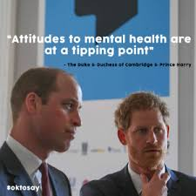
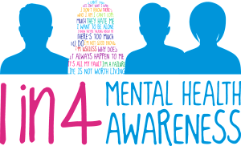
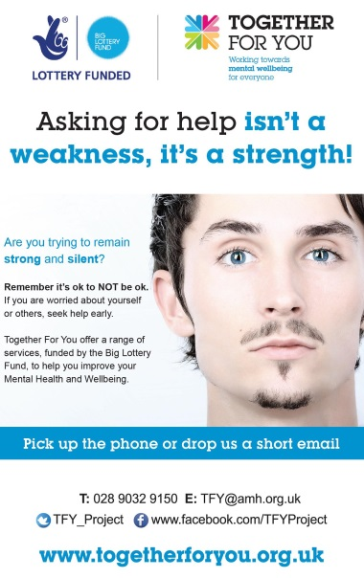

Slide 10
“I’ve got one of yours here.”
Which one?

Slide 11
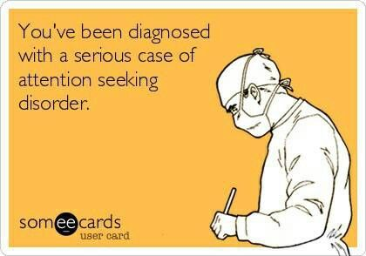

Slide 12
Identification of suicide risk
identified as
“high risk”
identified as
“low risk”
Notes:
Suicide mitigation is a different way of thinking about individuals at risk from suicide and starts from the assumption that self-harm and suicidal thoughts need to be taken seriously and met with empathy and understanding on every occasion. Instead of focusing on quantifying and characterising suicide risk so that it can be ‘managed’, the emphasis in suicide mitigation is on identifying the person’s individual risk factors, needs and strengths, instilling hope and empowering them to seek and accept support. This involves compassionately engaging with someone at risk of suicide, undertaking a tailored triage assessment, making a referral when indicated and jointly creating a safety plan with an agreed and explicit reference to removal of access to means.
Suicidal people are extremely ambivalent and their life can be saved up until the final moment. Compassionate communication with people at risk of suicide can save lives, is essential to the quality of the information underpinning an assessment and can be the tipping point back to safety.. The majority of people who end their lives by suicide are not in touch with mental health services around the time of their death. However they almost always have contact with someone.

Slide 13
Risk Mitigation
EVERY expression of suicide or self-harm thoughts are to be taken seriously and met with empathy and understanding on every occasion.
View the individual as a set of needs and strengths
Identify and mitigate the risk factors
Can they be modified and reduced?
Can you mitigate against the underlying reason?
Increase protective factors
Notes:
Identify and mitigate the risk factors
Can they be modified and reduced?
Can you mitigate against the underlying reason?
Increase protective factors

Slide 14
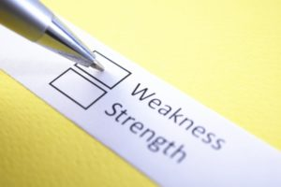

Slide 15
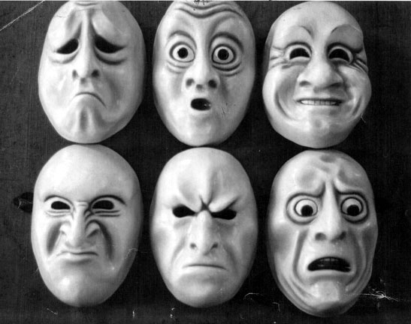
Emotions ………
Notes:
The next line of tension…. The binary of emotions
discuss Olivier Lang and the gentrification of emotions…
Summarise- emotions just are, often completely normal and appropriate responses to some of the inequalities and injustices that exist all around them…. They act as a cue from the brain to do something about them…………….
The dominant message seems to assist us to ameliorate negative emotions and increase positive emotions… but consider neither joy or sorrow have any value or can be experienced if not experienced at all !

Slide 16
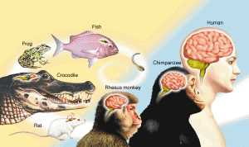
Notes:
We would make a case for compassion to be the baseline of understanding and any efforts to increase awareness around mental health and distress ...............
But what is it ?
SCIENCE ; Hard Science understanding of what the brain gets up to, how it functions and ticks; with particular reference to how it responds to threat and excitement in equal measure. We have a human and animal brain, the neo cortex and amygdala that communicate and relay messages in order to keep us alive and safe. When our brain struggles to affiliate distress triggers either chemically or cognitively, this can serve to make us feel unsettled, unsafe and unwell physically and emotionally. We struggle to recognise, tolerate and respond to the distress of others, if our own distress is not.
Psycho Neuro Immunology is a principle of how our physical health and mental health are interlinked and we cannot and should not consider one with out the other
An ability to recognise and a commitment to respond to the distress of self and others, based on a hard science understanding of how the brain functions and steers us. Emphasis on mindful awareness (awareness and sensitivity to suffering) combined with workable action (helping and motivation to help).
SCIENCE ; Hard Science understanding of what the brain gets up to, how it functions and ticks; with particular reference to how it responds to threat and excitement in equal measure. We have a human and animal brain, the neo cortex and amygdala that communicate and relay messages in order to keep us alive and safe. When our brain struggles to affiliate distress triggers either chemically or cognitively, this can serve to make us feel unsettled, unsafe and unwell physically and emotionally. We struggle to recognise, tolerate and respond to the distress of others, if our own distress is not.
SYMPATHY and EMPOWERMENT; Much of who we are, is not our fault. We had no control or choice over the brain we have and limited influence on the experiences that have shaped us through the meaning we have made of our experiences (many are locked in with in our formative years) HOWEVER this does not let us off the hook, the brain is malleable and we can develop new strategies for coping as well as means of either avoiding or recognising early our distress triggers and have a responsibility as adults to do so, this may take the support of others.
EMPATHY and VALIDATION; An acknowledgment that as a species we are more alike than we are unalike, yet we what makes us who we are as individuals will never be repeated as we are shaped (but not necessarily bound) by our experiences that collectively can never be repeated, ever again.
A DESIRE and NEED TO CONNECT; As a species, individually we do not thrive well. Our success and advancement is based on our ability to work together and support each other. We would not sacrifice our ability to connect with other human beings for anything
A BIAS TOWARDS OUR KIN; As a species, our survival has been enhanced by our kin bias. Given the choice of saving the life of a stranger or our child or sibling, we wouldn’t hesitate to choose our kin. Some species do not have this bias, we do.
INDIVIDUAL and COLLECTIVE ATTRIBUTIONS; Individually we find it easy to be compassionate and kind towards those we like, who share similar traits to our own and find it much more difficult to apply the same level of compassion and kindness to those who don’t. Collectively as a species we are incredibly tribal and what groups us can be our shared attributions or appearance, roles and beliefs; this can be our biggest curse as it creates space for inequality and injustice

Slide 17
Suicide Awareness
Distress
Ocean
Estuary
River
Stream
Self-harm Awareness
Emotional Resilience and Resourcefulness for self
Notes:
Instead of focusing on names, labels and words for our feelings and emotions… to avoid binary opposites of good and bad; and to ensure that compassion actually starts where it needs to, with ourselves; it’s a good check in mechanism for ourselves and indeed in our response to others, to consider where we are at on a water course………. Perhaps all we can achieve until the next day is to keep treading water and get ourselves to a safer path on the water course…. We can consider who may assist us with in any stage of the water course and what we may be able to do to assist ourselves …

Slide 19
Connecting with People Safety Plan
Element of Safety Plan | Immediate Plan | Long Term Plan
Reasons for living
Identify distress triggers
Safe environment
Activities to lift your mood
Calming activities
Distracting activities
Contact for general support/ distraction
Specific suicide prevention support
Professional support
Emergency contact details
Personal commitment to implement safety plan

Slide 20
The Staying Safe website helps you to build your own safety plan to keep you safe from suicidal thoughts. We advocate that everyone should consider what their own safety plan is, in the event that such feelings ever occur- they are the equivalent of break down cover for our cars- we don’t hope we need to use such cover, but should we need to, they are there in readiness and we can get home safe.
‘Staying Safe’ Training – is a free online training resource to support the use of Staying Safe website equipping participants with the skills and confidence both to make their own Safety Plan and to encourage and support others to do the same. Training has been designed to be used in a wide range of settings and roles, including the NHS and social care, first responders, third sector organisations, carers, peer support groups, community groups, schools and universities.
‘Staying Safe Resources’ to support Staying Safe Training-The resource contains helpful information, details of organisations to contact, and a blank Safety Plan template.
Wellbeing and coping – A similar principle to safety planning, is wellbeing and coping planning – a link to a resource to aid wellbeing an coping planning is included below- there are a number of links with in this page that include activities to enhance your wellbeing and coping, that can be conducted in 30 seconds- 3 minutes and 30 minutes
https://wellbeingandcoping.net/

Slide 21
