Slide 1
Feedback from Day 1
Christina Blakey, Strategic Business Development Manager (Skills)

Slide 2
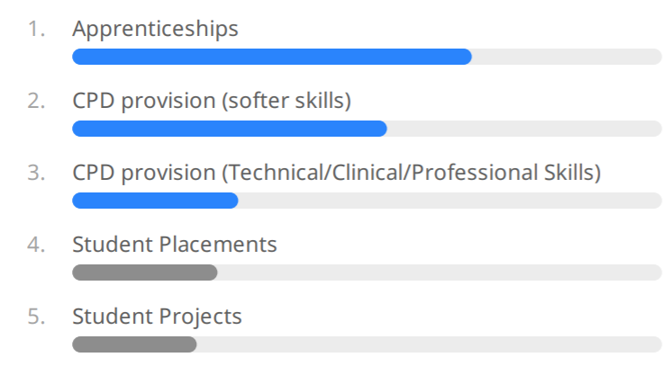
What activities would be of most benefit to you or your organisation?

Slide 3
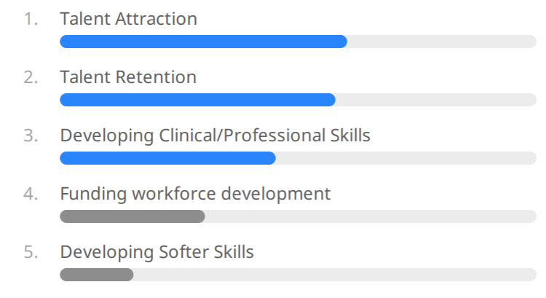
What are the biggest challenges you face currently and in the immediate future

Slide 4
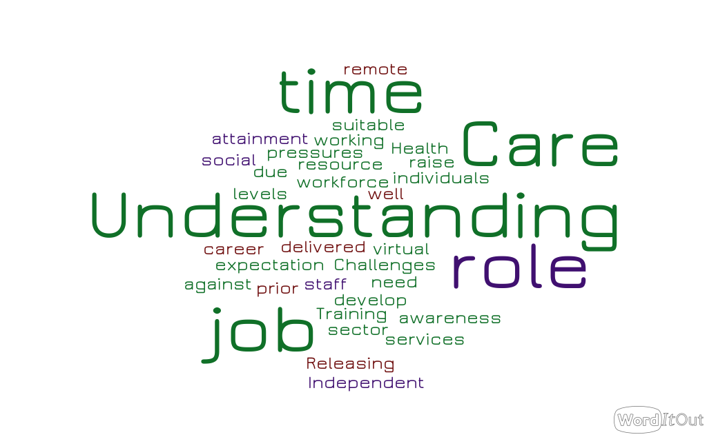
Are there any other challenges you are facing?

Slide 5
What are the clinical/technical skills that you need the most?

Slide 6
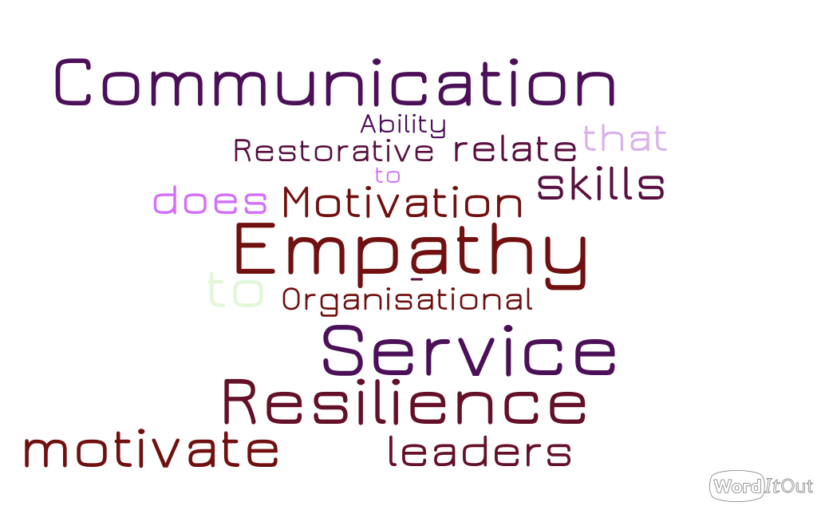
What are the softer skills you need the most?

Slide 7
What would you like to see us do more of?

