Slide 1
Research in UK Higher Education – The Challenges and Opportunities
Professor Geoff Layer

Slide 2
The Evolution of (UK) Universities
7 ‘ancient’ universities.
A small selection of universities received their Royal Charter in the 19th century.
‘Red brick’ universities were formed before WW1.
1960s - ‘plate glass university’.

Slide 3
The Evolution of (UK) Universities
‘Post-1992 universities’ or ‘modern universities’.
Distance learning e.g. OU.
HE White Paper - Alternative Providers.
Buying and selling of universities.

Slide 4
The Role of Universities
St Bede – The Venerable (672-735 A.D)
Greatest scholar of the medieval era.
‘The Father of English History’.
John Henry Newman (1801-1890)
‘And to set forth the right standard, and to train according to it, and to help forward all students towards it according to their various capacities, this I conceive to be the business of a University’.
Industrial need.

Slide 5
Richard Burden Haldane (1856-1928)
Decisions about what to spend research funds on should be made by researchers rather than politicians.
UK Funding Principles – Dual Support System
Structural/Infrastructure Support (QR) via HEFCE – links to Research Excellence Framework (REF).
Research Council UK, charities, the European Union and government departments provide grants for specific research projects and programmes.

Slide 6
Dearing Report
To enhance individual life chances by encouraging and enabling individuals to develop their own capabilities.
To increase knowledge and understanding to benefit the economy and society.
To serve the needs of an adaptable economy, regionally, nationally and internationally.
To play a major role in shaping a democratic, inclusive society.
Dearing (1997)

Slide 7
Context
Greater and increasing competition e.g. within Research Councils.
Brexit will reduce EU funding opportunities.
HE & Research Bill – pressure on Research England/UKRI.
Stern Review.
Doing more with less.

Slide 8
Research Councils & UKRI
7 Research Councils - grant support from UK government.
Universities that receive higher education grant funding from government are eligible to receive funds for research, postgraduate training and associated activities.
HE White Paper: UK Research & Innovation (UKRI) – brings together the 7 RCs, HEFCE’s research and knowledge exchange functions, and Innovate UK.

Slide 9
Implications (General)
A simplified process with decisions on funding allocations taken by experts.
A greater focus on cross-cutting issues enabling rapid response to current and future challenges.
Knowledge exchange transfers to UKRI.
Safeguards introduced to protect the integration of teaching and research at the national as well as the institutional level.

Slide 10
Implications (for HEIs with smaller research profiles)
Harder to access funding.
A harsher environment for new researchers.
Recruitment of new researchers and research active staff will be challenging.
Greater reliance on funding from industry.
Major issues for ‘blue-sky’ research.

Slide 11
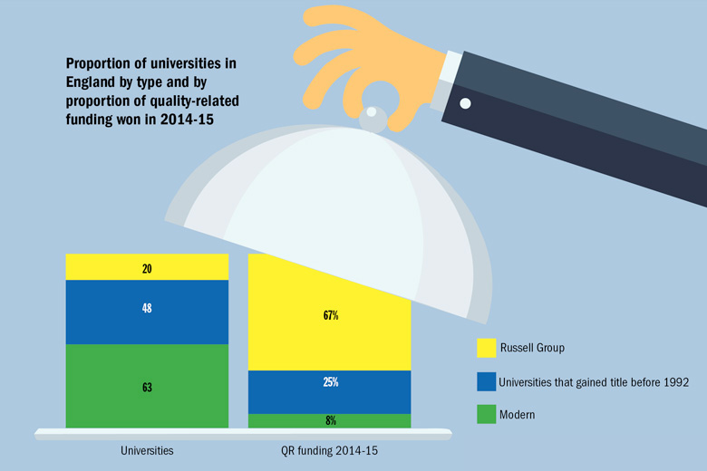
A Funding Imbalance

Slide 12
Research Excellence Framework (REF)
Determines the quantum of resources that we get for research infrastructure.
An assessment of research excellence – not a judgement on all our research.
Stern Review.

Slide 13
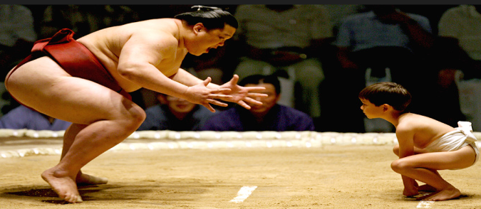
Implications of Stern
The end to so-called research portability.
All research active staff are entered in REF - removing ‘selectivity’.
Two outputs submitted per researcher, with the option for some to submit up to six, and others less.
The definition of impact to be ‘broadened and deepened’ and better aligned to the TEF – on curricula and pedagogy.

Slide 14
Implications of Stern
Link case studies to research activity and a body of work, as well as to a broad range of research outputs, rather than specific papers or monographs.
Possible push to low quality predatory journals.
Universities to have more flexibility over how many impact case studies to submit from each unit of assessment – enable institutions to ‘demonstrate their strengths more effectively’.
Focus on multi and interdisciplinary and collaborative work.

Slide 15
Indicative Research Tail
e.g. Research Intensive University: REF 2014
e.g. Non Research Intensive University: REF 2014
Output Quality | 0* | 1* | 2* | 3* | 4*
Staff (%) | 10 |  | 40 | 50
Output Quality | 0* | 1* | 2* | 3* | 4*
Staff (%) | 65 |  | 10 | 25

Slide 16
HEFCE Consultation on Stern
14 week consultation from the end of November 2016.
We need a clear response using established fora e.g. UUK, subject specific routes and learned societies.

Slide 17
Research Data Management
RDM - managing, storing and making accessible the data generated by research
Challenges | Opportunities
Lack of certainty over value placed by the sector on research data management. Reluctance by researchers to share data. Cost – can be high and future costs are hard to predict. Technical challenges – wide variety of formats to be kept and made accessible for a long time. Security issues around storage and release. | Opens up research possibilities. Helps combat research fraud and misconduct – makes it much easier to verify results. Creates greater public value from public funding – makes research results available to all. Increases citations and reach – datasets can be cited directly as well as articles.

Slide 18
Our RAE/REF Journey
A long journey from sub-national to internationally excellent research
Percent 4* and 3*
1992 1996 2001 2008 2014
Allied Health Professions, Dentistry, Nursing and Pharmacy 1 2 3a 20 54
Engineering no submission 2 3a 30 22
Architecture, Built Environment and Planning 2 3b 3a 50 26
Business and Management Studies no submission 2 3b 20 29
Law 1 1 3a 25 12
Education 2 1 2 20 41
Sport and Exercise Sciences, Leisure and Tourism no submission 1 3a no submission 44
Area Studies 2 3b 3a 25 29
Modern Languages and Linguistics no submission no submission 3a 55 49
English Language and Literature no submission no submission no submission no submission 32
History 2 3a 4 30 55
Art and Design: History, Practice and Theory 2 2 3a 35 43
Media Studies, Library and Information Management 2 1 2 65 89

Slide 19
Our Research Income
Research Council (RCUK): Between 2003-2015 we secured circa £3m from RCUK – comparable with other post-92 universities.
QR – quality related research funding (HEFCE) – linked to REF.
EU Grants
Industry
Charities
PGR – Students Fees
University of Wolverhampton – Research Investment Framework (RIF)

Slide 20
Role of Professor
Be an academic leader in your field.
Supervise doctoral students and help proactively shape and develop research careers.
Impart knowledge and experience in the classroom.
Produce relevant, appropriate and high quality research outputs linked to discipline.
Secure income above average for UoA.

Slide 21
1. Realising the Ambition
Build and enhance our critical mass i.e. larger Research Institutes and investment in capacity.
Develop better linkages between teaching and research & research and business engagement.
Through rigorous business planning, build our impact and reach i.e. outside immediate academic area(s).
Enhance leadership, management and performance management role/functions.

Slide 22
2. Realising the Ambition
A focus on inter and multidisciplinary research activity.
Some single subject focus but hard to maintain.
Gender action plan.
Grow our own researchers.

Slide 23
3. Realising the Ambition
Develop a community of research.
Develop strategic partnerships (not opportunistic).
Demonstrate the value of our research including research informed teaching.
Focus on applied research and innovation.

Slide 24
University Investment
Doctoral College
RIF 1& 2 (£6m)
RIF 3 (£6m)

Slide 25
Research Investment Fund (RIF)
RIF 1 – Investment in REF 2014.
RIF 2 – Build research capacity for the future.
RIF 3 – Strategic investment.

